Slide 1
Case Study: The Vajont Dam
Andrew Luna, Logan Palmer, and Landon Kinney

Slide 2
Introduction video
https://www.youtube.com/watch?v=U_inRwdeQr0

Slide 3
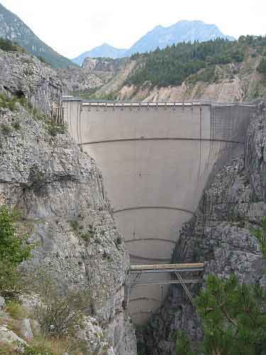
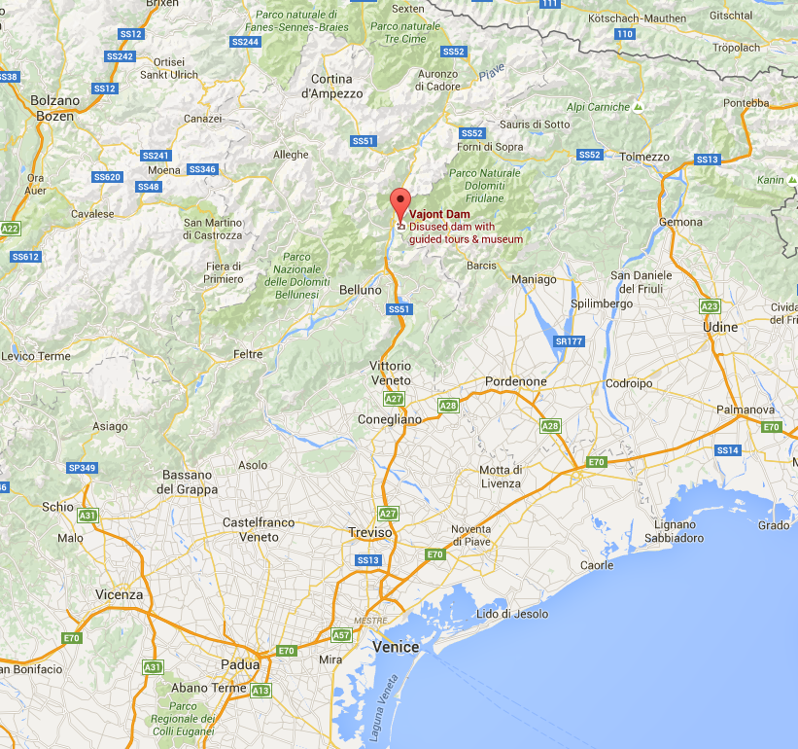
114 km or 71 miles
Location of Vajont, Italy
The Vajont Dam

Slide 4
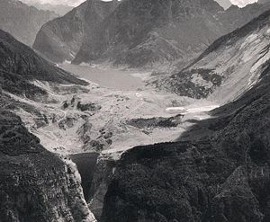
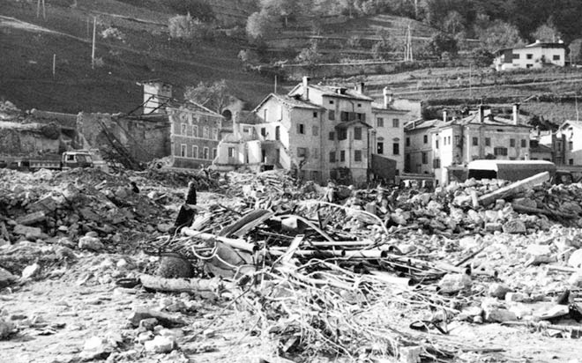
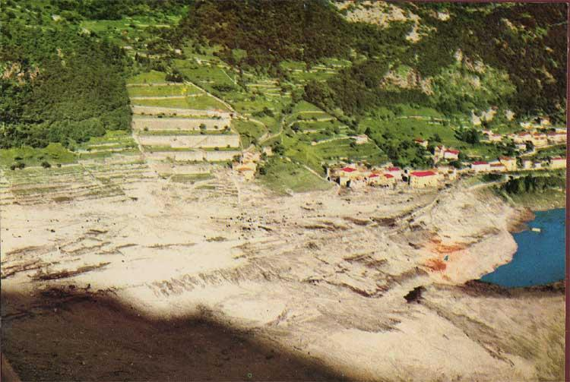
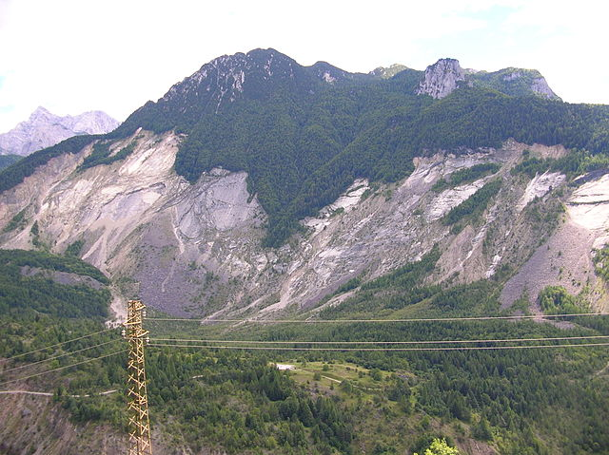
270 million cubic meters of earth slide
Landslide reached 68 mph
Caused an 820 ft wave that overtopped that dam
Destroyed 6 Italian villages
Notes:
2,000 + people died.

Slide 5
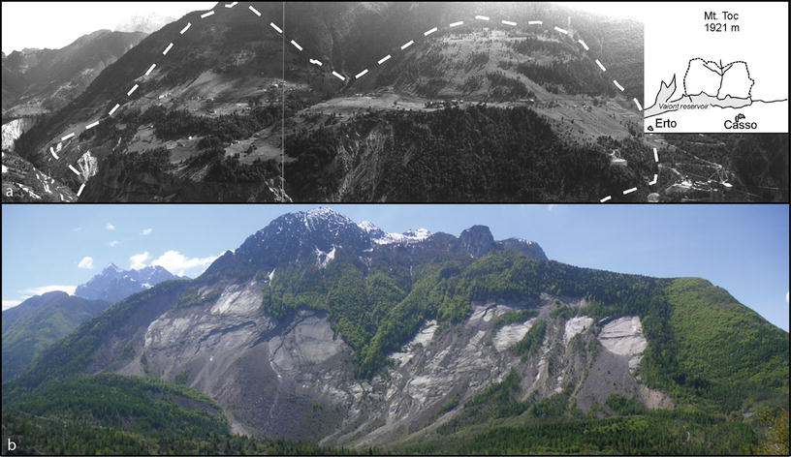
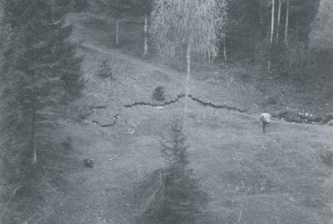

Slide 6
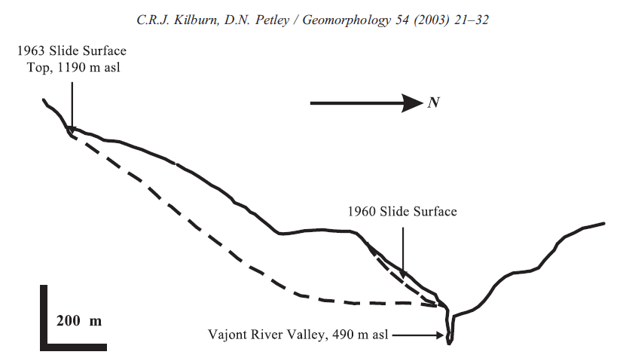
Notes:
1960 - 70,000 cubic meters of soil slid
1963 - 270,000,000 cubic meters

Slide 7
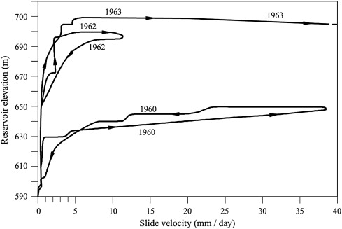
Effects of Rapid filling and drawdown

Slide 8
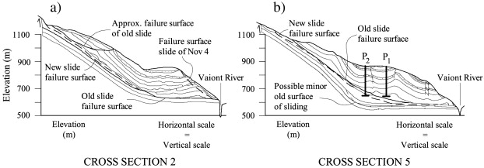
Failure planes
Notes:
Thin layer of clay in the limestone was the failure surface. Some argue that this surface remains from an ancient landslide.

Slide 9
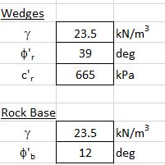
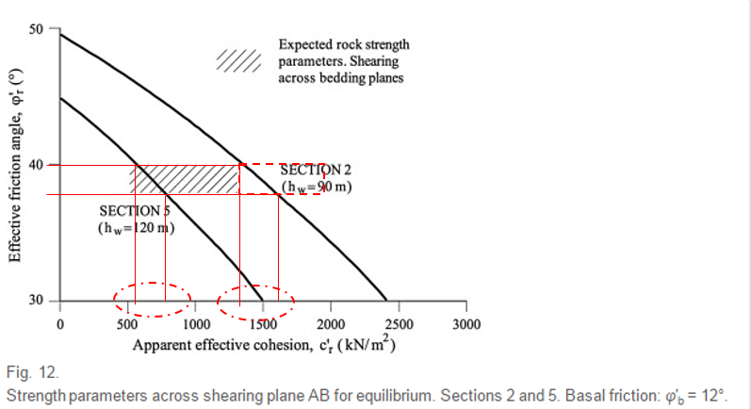
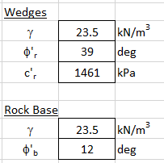
SECTION 2
SECTION 5

Slide 10
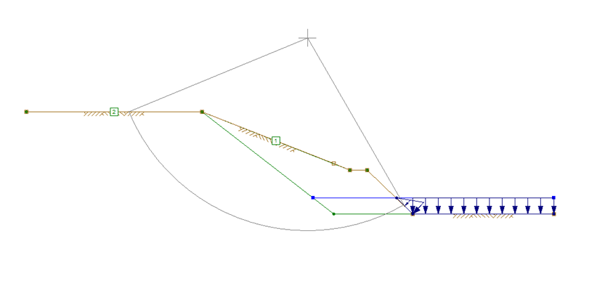
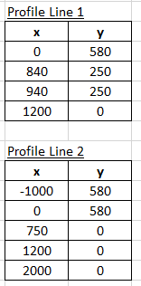
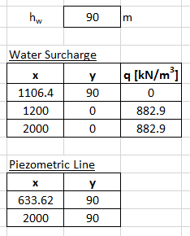
SECTION 2

Slide 11
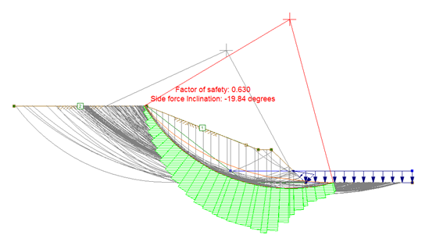
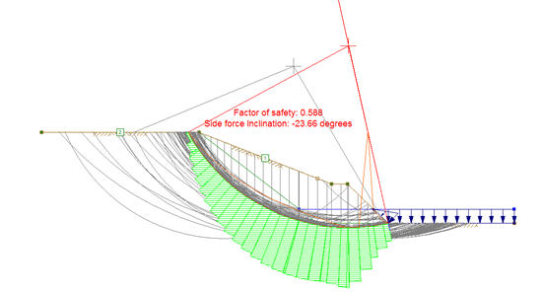
Failures and F.S.
FS = 0.630
FS = 0.588

Slide 12
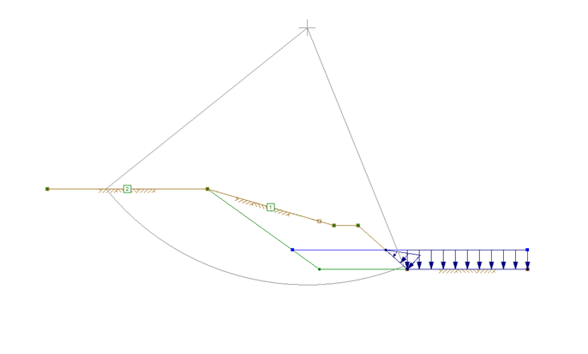
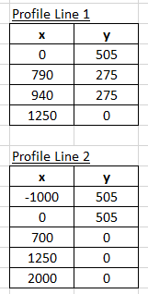
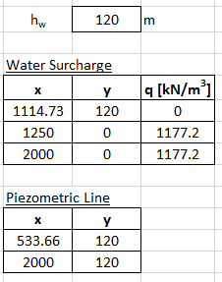
SECTION 5

Slide 13
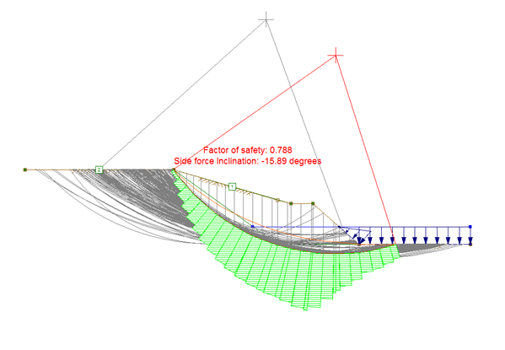
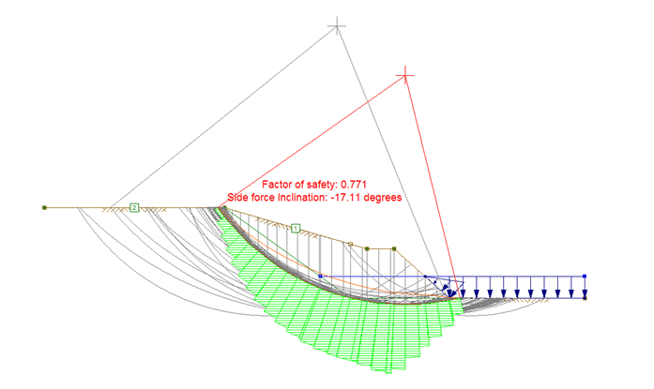
Failures and F.S.
FS = 0.788
FS = 0.771

Slide 14
Summary

Slide 15
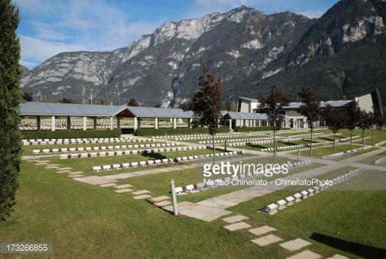
Questions?

